Slide 1

Introduce to Python Course
Presented by Patel Niyati

Slide 2
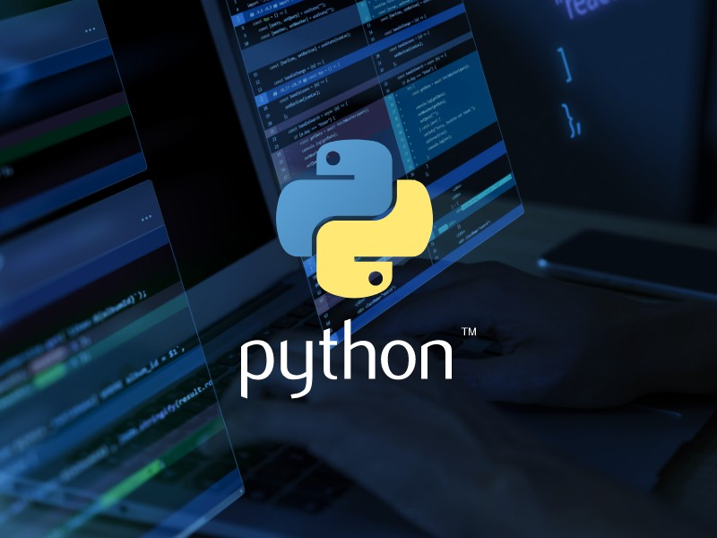
Python

Slide 3
Why choose it field.
I have choose it field because Python’s high demand, strong community support, an abundance of libraries and frameworks and strong job growth are just a few of the reasons.
Python is the top preferred language for data science and research.
Python can be used for tasks, such as web development, data analysis, machine learning, game development, GUI application, and many more.

Slide 4
Learning in growth
Python’s popularity in data science and machine learning is probably the main driver of its fast growth.
The benefits of Python for building Machine Learning systems and the major tools and frameworks typically used to solve Machine Learning problems.
EX: 1)Django: Django is a free and open-source, Python-based web framework that runs on a web server. It follows the model–template–views architectural pattern.
2) Flask
3) CherryPy

Slide 5
Where is Python used in daily life?
Top Uses of Python in the Real World
Web Development.
Data Science.
Artificial Intelligence and Machine Learning.
Game Development.
Software Development.

Slide 6
History of Python
Python 1
Python 1 launched in 1994 with new features for functional programming, including lambda, map, filter and reduce.
It also included features from 0.9 Python, including classes with inheritance, exception handling, functions, and the core data types list, dict, str.

Slide 7
Python 2
Python 2 launched in 2000 with big changes to source code storage.
It introduced many desired features like unicode support, list comprehension, and garbage collection.

Slide 8
Python 3
Python 3.0 is the biggest change the language has undergone.
The main mission of the update was to remove fundamental design flaws with the language by deleting duplicate modules and constructs.
This update introduced improved error messages. Several error messages now come with helpful suggestions.
This update also optimized garbage collection and object traversal, leading to better overall memory management.

Slide 9
What’s the future of Python
In 2019, Python was declared as the fastest-growing programming language in the world, and it now has one of the largest programming communities. This growth is expected to continue following the 2020 lockdowns, which spiked a surge in AI, automation technologies, and data science tracking.
This naturally leads many to invest heavily in data science predictive analytics, even in non-tech sectors like tourism, real estate, health care, and more.
In 2024, Python stands as a versatile, powerful, and accessible programming language that opens numerous doors in the tech industry.

Slide 10
Thank You!!!

